Slide 1
Inpatient Management of Cirrhosis
Suchita Shah Sata, MD, FACP, SFHM
Hospitalist, Duke University
Elliot Tapper, MD
Hepatologist, University of Michigan

Slide 2
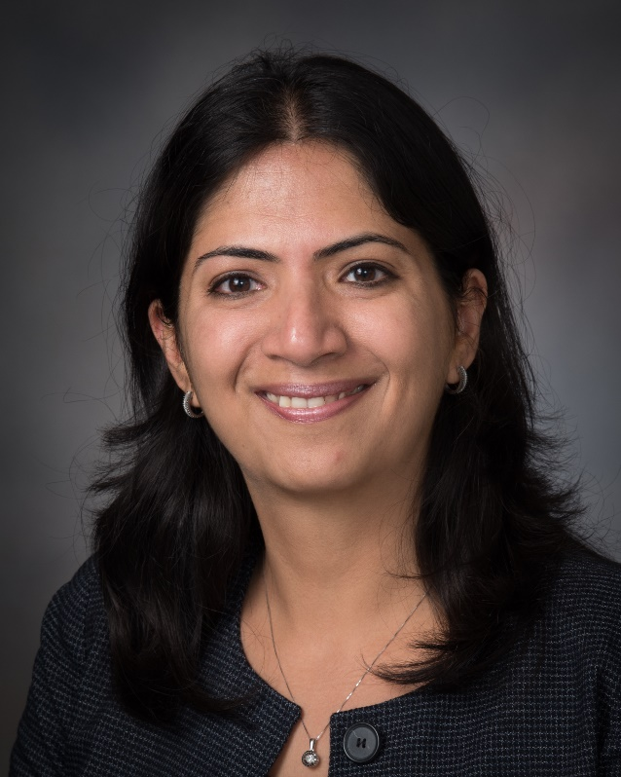
Dr. Jagriti Chadha, MD, FHM
Associate Professor at the University of Kentucky, Division of Hospital Medicine
Medical Director, Physician Development
SHM Education Committee member

Slide 3
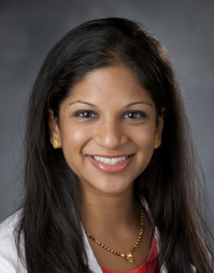
Dr. Suchita Shah Sata, MD, FACP, SFHM
Hospitalist and Assistant Professor of Medicine at Duke University Hospital
SHM Education Committee member

Slide 4

Dr. Elliot Tapper
Associate Professor at the University of Michigan,
Hepatology
Director, Michigan Cirrhosis Program
Editor-in-chief, Hepatology Communications

Slide 5
Attestation Disclosure to the Audience
The faculty and planners of these activities have no relevant relationships to disclose unless denoted below. All relevant relationships were mitigated prior to the start of this activity.
Dr. Tapper reports receiving research funds from Valeant as well as serving as a consultant for Satelite Bio, Ambys; Takeda, Madrigal, and NovoNordisk.
Conflict Of Interest Disclosure Policy
In accordance with the ACCME Standards for Commercial Support, SHM requires that individuals in a position to control the content of an educational activity disclose all relevant financial relationships with any commercial interest. SHM mitigates all conflicts of interest to ensure independence, objectivity, balance, and scientific rigor in all its educational programs. All relevant financial relationships shall be disclosed to participants prior to the start of the activity.
Furthermore, SHM seeks to verify that all scientific research referred to, reported, or used in a continuing medical education (CME) activity conforms to the generally accepted standards of experimental design, data collection, and analysis. SHM is committed to providing its learners with high-quality CME activities that promote improvements in healthcare and not those of a commercial interest.

Slide 6
Initial Hospital Evaluation

Slide 7
Mr. Murphy
Jaundice
+ Fluid wave
What’s the next best step in management?
Furosemide 20mg IV
Furosemide 20mg PO
Diagnostic paracentesis +
RUQ U/S + Doppler
Therapeutic paracentesis
WBC 6.3
Cr 1.1
INR 1.9
56 y/o M presents to the ED for new-onset abdominal swelling.
@SuchitaSata
Notes:
Mr. Murphy is a 56 y/o M who presents to the ED for new-onset abdominal swelling.
He has not sought medical attention in about 10 years.
He drinks a pint of whiskey each night though the past couple weeks he has not felt well enough to really drink much.
His exam shows a jaundiced thin man with a protuberant abdomen with an obvious fluid wave. His abdomen is not tender, he has had no fevers.
WBC 6.3
Cr 1.1
INR 1.9
The ED requests admission to the hospitalist service for management.
Answer is C – diagnostic paracentesis

Slide 8
Why this patient? Why now?
Ascites
SBP
AKI
GI bleeding
PVT
Meds
Toxins
Diet
Infections
HCC
Surgery
Triggers
Ascites
Hydrothorax
SBP
AKI
GI bleeding
PSE
Clinical
signs
@SuchitaSata
Notes:
Clinical manifestations of decompensation and triggers for decompensation are intertwined and essentially the same list
Diuretics for ascites can lead to AKI.
SBP can lead to AKI
GIB can lead to SBP
Decompensation is a syndrome – what is the etiology

Slide 9
Mr. Murphy
Jaundice
+ Fluid wave
What’s the next best step in management?
Furosemide 20mg IV
Furosemide 20mg PO
Diagnostic paracentesis +
RUQ U/S + Doppler
Therapeutic paracentesis
WBC 6.3
Cr 1.1
INR 1.9
56 y/o M presents to the ED for new-onset ascites.
@SuchitaSata
Notes:
Mr. Murphy is a 56 y/o M who presents to the ED for new-onset abdominal swelling.
He has not sought medical attention in about 10 years.
He drinks a pint of whiskey each night though the past couple weeks he has not felt well enough to really drink much.
His exam shows a jaundiced thin man with a protuberant abdomen with an obvious fluid wave. His abdomen is not tender, he has had no fevers.
WBC 6.3
Cr 1.1
INR 1.9
The ED requests admission to the hospitalist service for management.
Answer is C – diagnostic paracentesis

Slide 10
Initial Ascites Evaluation

Slide 11
Diagnostic paracentesis
Who should undergo a diagnostic paracentesis?
What studies should be sent from the ascitic fluid?
Clinically apparent,
new-onset ascites
Known ascites, admitted to the hospital for any emergent reason
Signs/ Symptoms of infection
Cell count
Culture
Fluid protein
Fluid albumin
Gram stain
Serum albumin
*Don’t have to repeat these studies each time
@SuchitaSata
Notes:
Spontaneous bacterial peritonitis (SBP) is often asymptomatic and early treatment is associated with improved outcomes. Accordingly, patients with ascites who undergo a diagnostic paracentesis on admission have reduced in-hospital mortality.
AASLD guidelines:
-A diagnostic paracentesis should be performed in all patients with new- onset ascites that is accessible for sampling
The initial laboratory investigation of ascitic fluid should include ascitic fluid neutrophil count, ascitic fluid total protein, ascitic fluid albumin, and serum al-bumin to calculate the serum- ascites albumin gradient
ascitic fluid protein and albumin should be placed on initial diagnostic paracentesis. Does not need to be done on subsequent ones

Slide 12
Fluid study interpretation
SAAG > 1.1 g/dL = portal HTN
Fluid protein > 2.5 g/dL =
likely cardiac etiology
PMN >250/mm3 = SBP (Spontaneous Bacterial Peritonitis) with or without bacterascites
Apply similar rules to hydrothorax and Spontaneous Bacterial Empyema (SBE)
Cell count
Culture
Fluid protein
Fluid albumin
Gram stain
Serum albumin
@SuchitaSata
Notes:
SAAG – serum-ascites albumin gradient. Subtract fluid albumin from serum, >1.1g/dL suggests portal HTN
High fluid protein suggests cardiac cause
The diagnosis of SBP/SBE is established with a fluid polymorphonuclear (PMN) leukocyte count >250/mm3

Slide 13
Diuretic Strategies

Slide 14
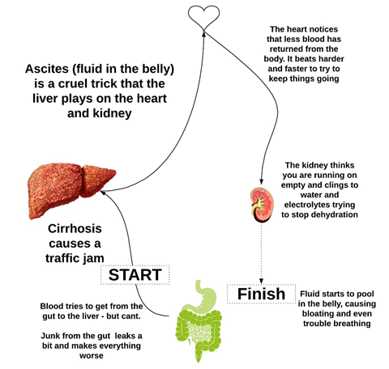
Key point:
Ascites is caused by the renal response
to decreased effective arterial volume
(Very high RAAS activity)

Slide 15
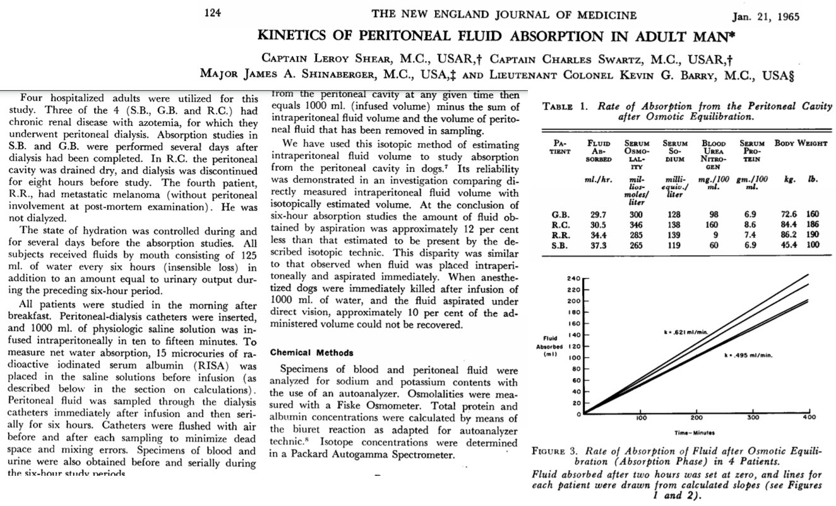
Key point:
The speed limit for ascites
clearance is 1L / day

Slide 16
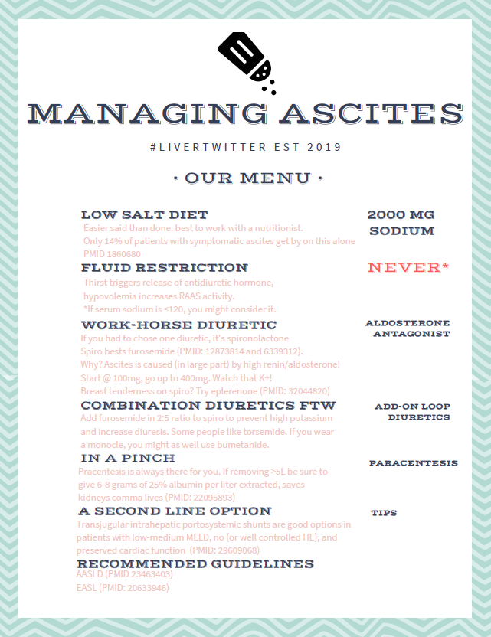
Key points:
Don’t add salt
Max the spiro
Furosemide clears K
25% Albumin if large
volume paracentesis
Bonus:
Eplerenone is ½ strength,
½ half-life of Spiro

Slide 17
SBP management

Slide 18

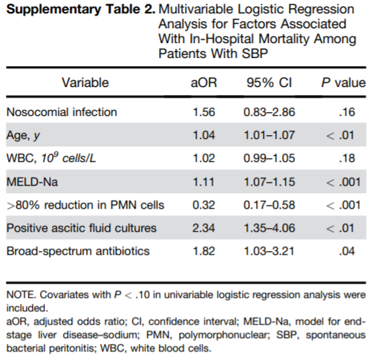
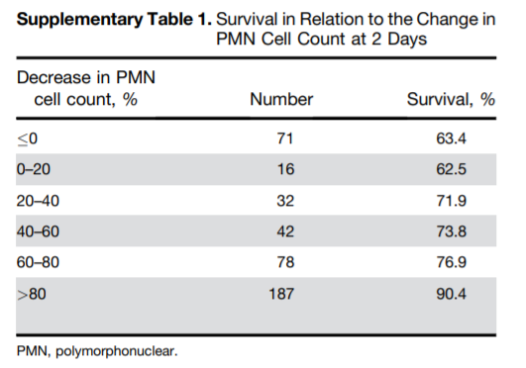
TWO taps > ONE

Slide 19
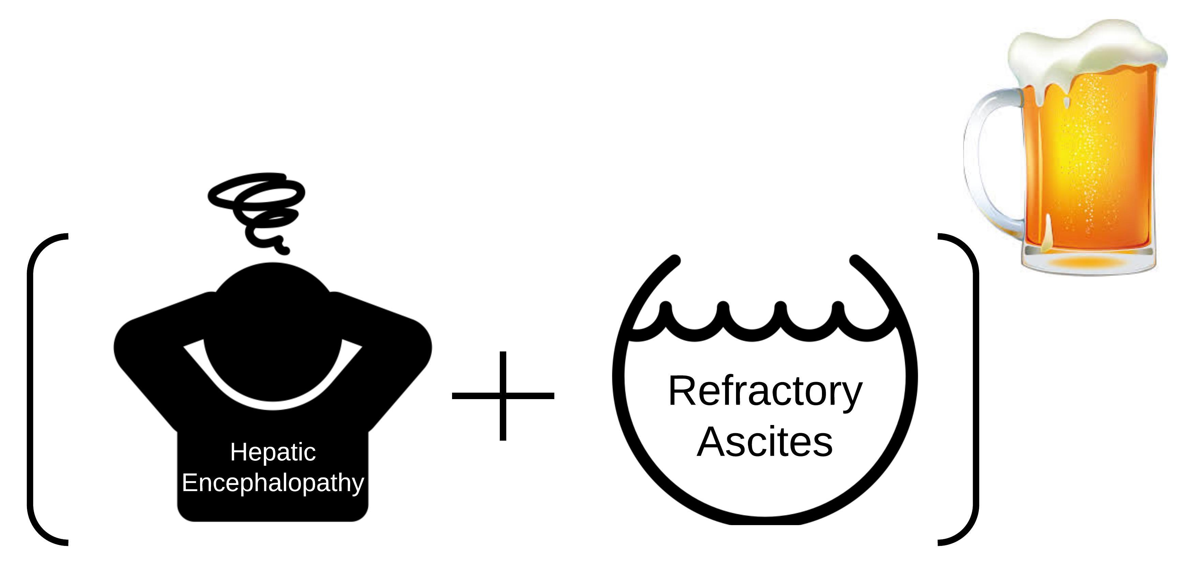
SBP
>250 neutophils
+/- Positive culture
Everything you need to know about SBP in one slide
2 grams ceftriaxone or broader (think ‘HCAP’)
1.5 g/kg 25% albumin IV
48 hour diagnostic para! (25% empiric tx failure rate)

Slide 20
Hepatic Encephalopathy

Slide 21





Why ammonia doesn’t work
Handled incorrectly
No upper limit of normal
No difference in outcomes, management

Slide 22
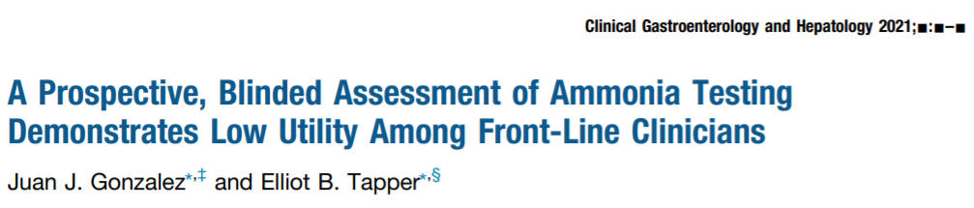
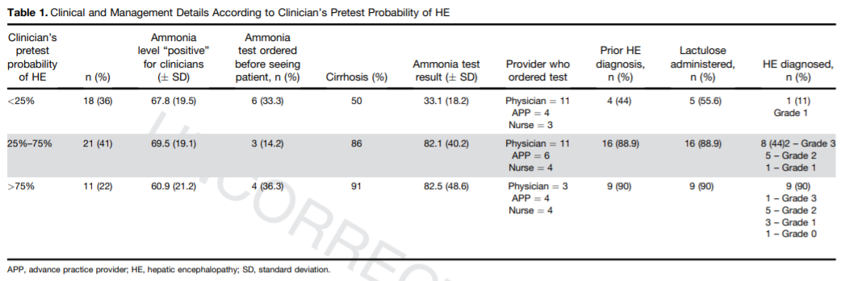
Key point:
Ammonia levels do not change the
to the hospitalist’s pre-test diagnosis

Slide 23
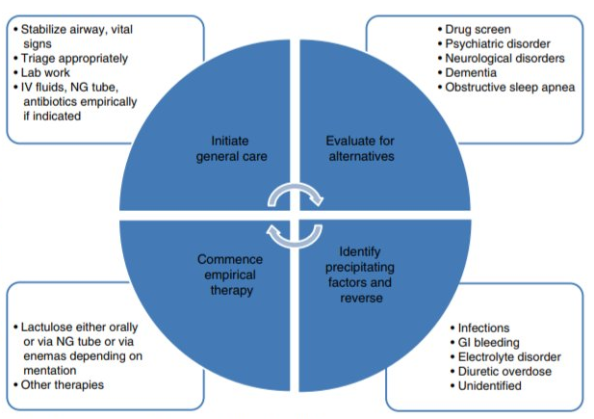

Slide 24
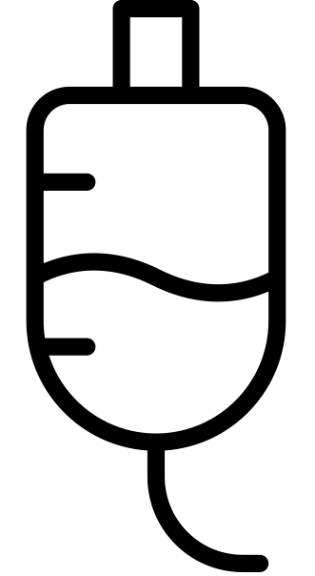

First.
Line.
Therapy.

Slide 25
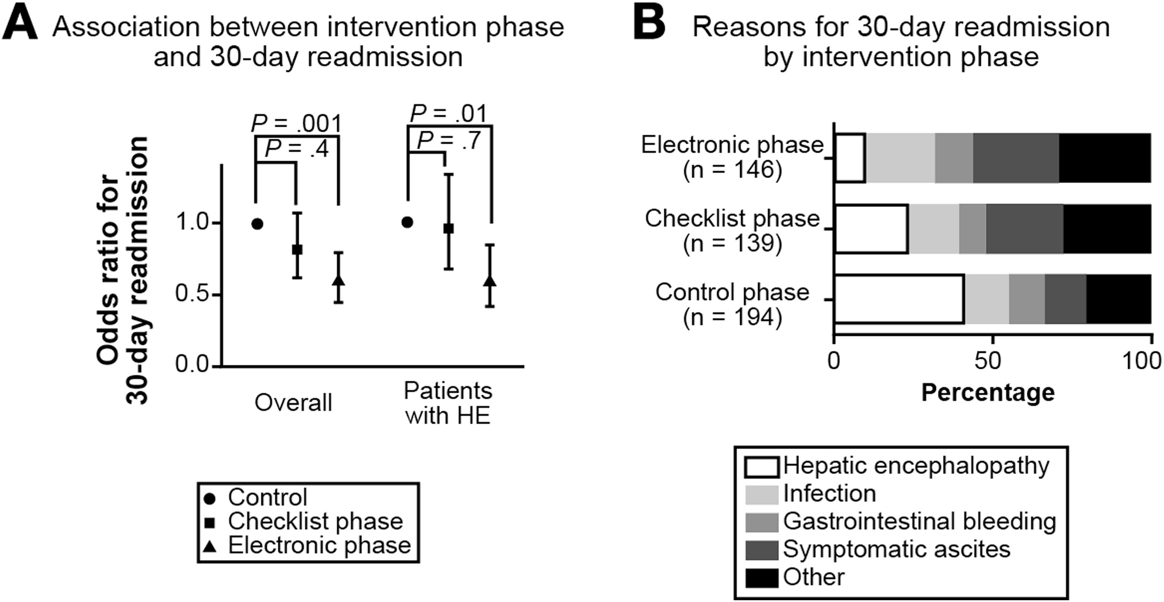
Quality Improvement Initiative Reduces 30-day Readmissions
Tapper E, Clin Gastroenterol Hepatol 2016; 14: 753

Slide 26
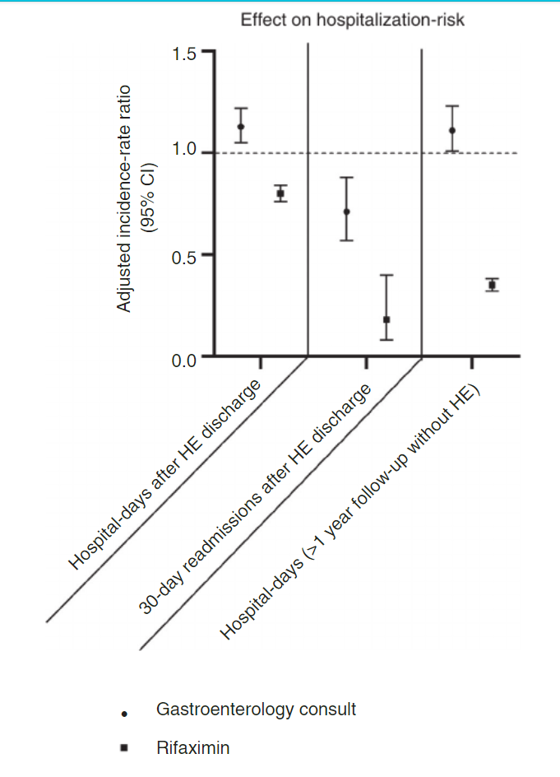
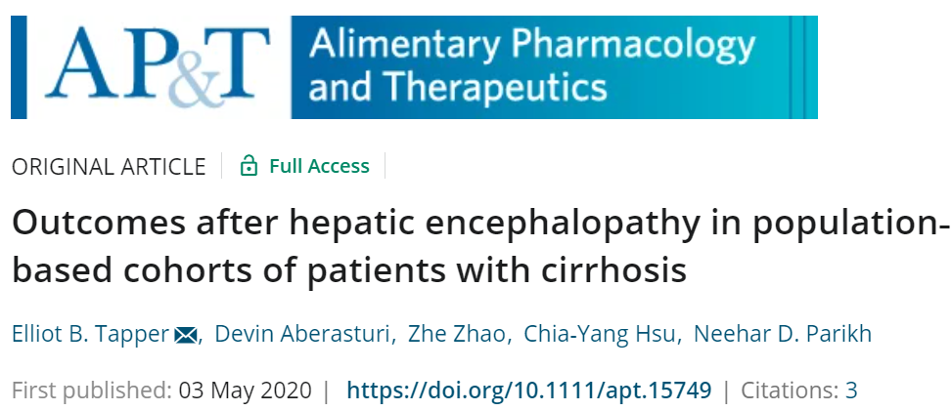
Rifaximin
Reduced breakthrough episodes
Post-COI

Slide 27
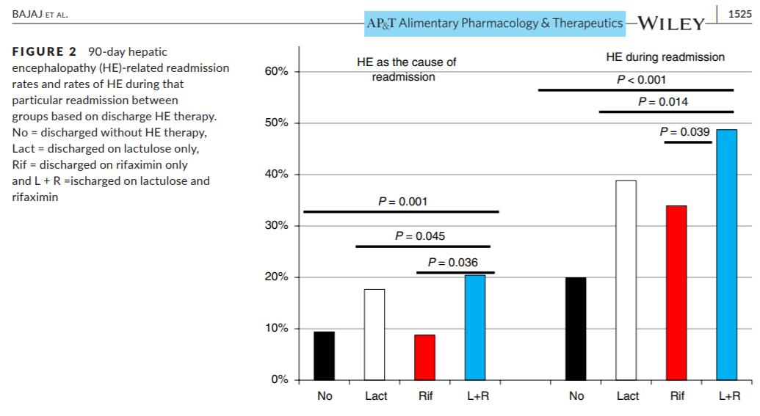
Lactulose on discharge

Slide 28
Hepatorenal Syndrome – Acute Kidney Injury
(HRS-AKI)

Slide 29
Mr. Jackson
Spironolactone 100mg, furosemide 40mg daily
Ciprofloxacin 500mg daily
Cr 2.9 (from 1.4) mg/dL Na 129 (135) mmol/L
Diagnostic para without SBP RUQ U/S without PVT
61 y/o M w/ HCV cirrhosis with ascites.
Presents with dizziness and fatigue.
@SuchitaSata
Notes:
New case.
Mr. Jackson had HCV that was treated and is in SVR now
Unfortunately has cirrhosis with ascites
He’s on appropriate medication for ascites management and takes it routinely
He has low fluid protein so is on ciprofloxacin for SBP ppx
He is admitted with AKI and hyponatremia and has the appropriate initial evaluation with paracentesis and dopplers

Slide 30
Mr. Jackson
What’s the next best step in management?
Consult nephrology
Obtain renal ultrasound
Stop diuretics
Administer IV diuretics
61 y/o M w/ HCV cirrhosis with ascites on diuretics.
Presents with dizziness and fatigue. Has AKI.
@SuchitaSata

Slide 31
Mr. Jackson
What’s the next best step in management?
Consult nephrology
Obtain renal ultrasound
Stop diuretics, volume expand (IV albumin), improve renal perfusion (vasoconstrictors, octreotide)
Administer IV diuretics
61 y/o M w/ HCV cirrhosis with ascites on diuretics.
Presents with dizziness and fatigue. Has AKI.
@SuchitaSata

Slide 32
HRS-AKI management

Slide 33
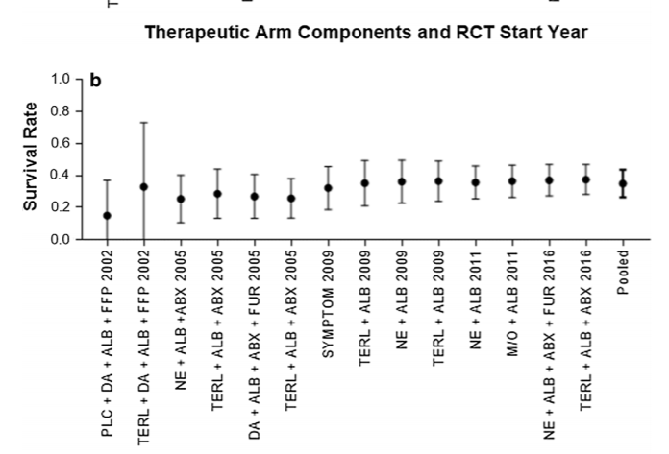
Limited progress in HRS

Slide 34
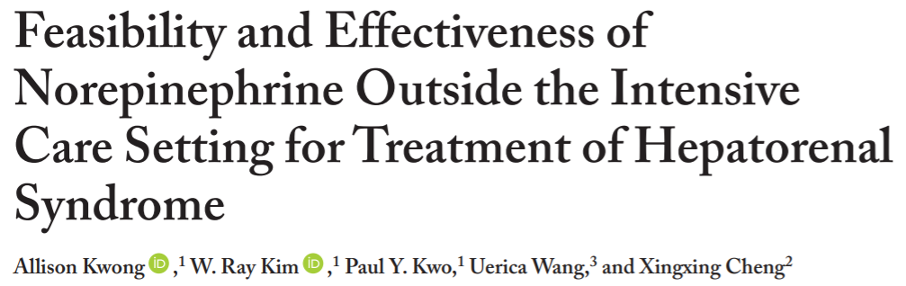
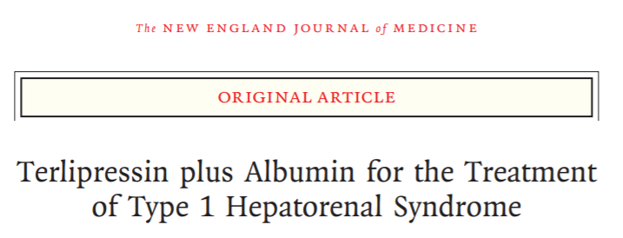
Ways to improve outcomes
Use real vasopressors
Careful with albumin
Individualize the albumin

Slide 35
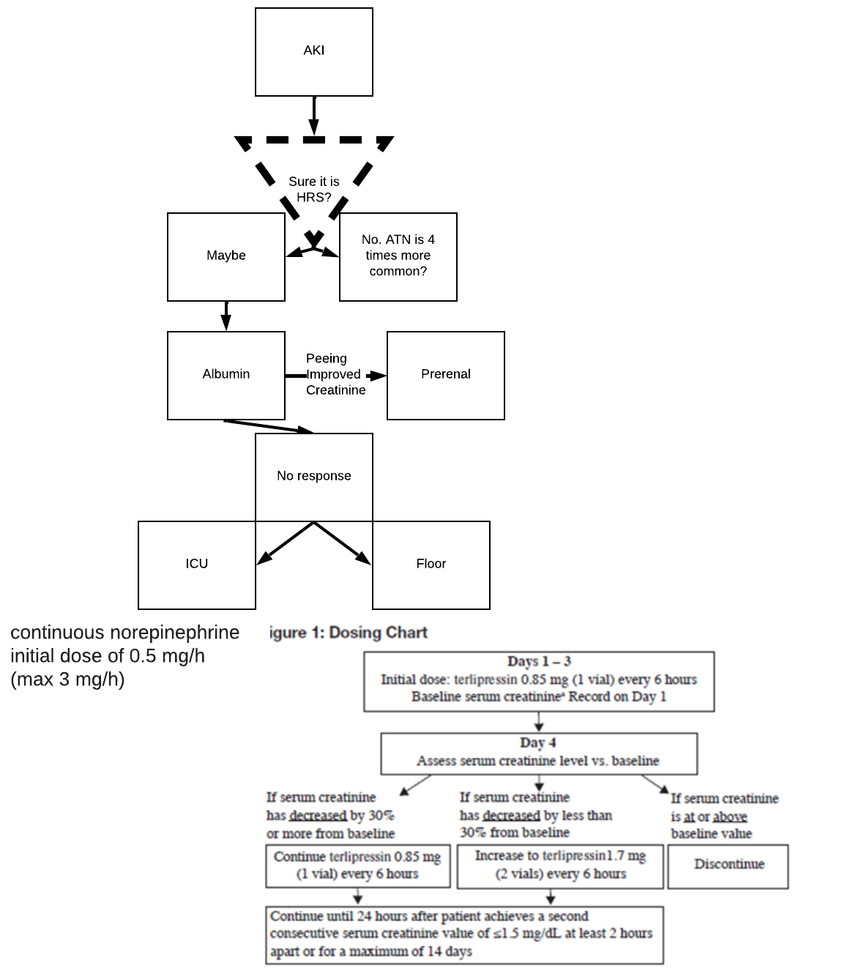
Key points:
HRS is uncommon
Albumin challenge
Norepi vs Terli for true HRS (Cr <5)
Watch for pulmonary edema

Slide 36
Hyponatremia

Slide 37
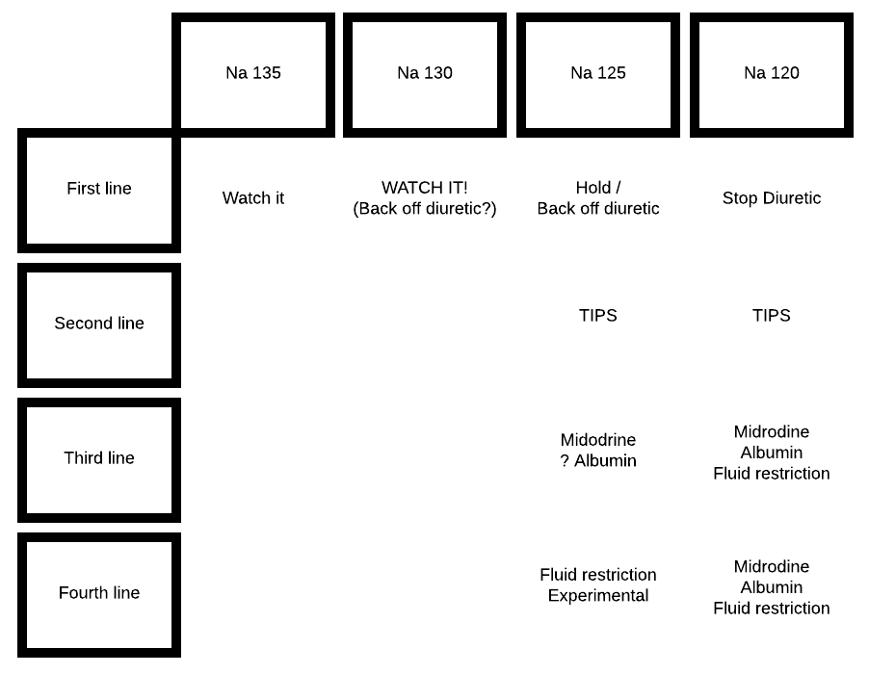

Slide 38
GI Bleeding

Slide 39
Mrs. Santos
Hgb 10.4
What’s the next best step in management?
Consult GI for EGD
Start octreotide bolus + infusion
1g ceftriaxone
All of the above
Hgb 9.3
IV PPI
Admitted
45 y/o F with NASH cirrhosis with ascites
3 episodes of hematemesis
@SuchitaSata

Slide 40
Upper GI (Variceal) Bleeding
Reduce portal pressure
Octreotide: 2-5 days then NSBB
Conservative transfusion goal: Hgb 7-9 g/dL
TIPS (transjugular intrahepatic portosystemic shunt)
Antibiotic prophylaxis (ceftriaxone 1g/day)
GI consultation
  EGD
  Band ligation of varices
@SuchitaSata
Notes:
We worry about acute variceal bleeding
Though there are other complications of cirrhosis that can bleeding including in particular portal hypertensive gastropathy
No way to tell without direct visualization so a GI consult for EGD
Octreotide is a somatostatin anologue – bolus 50mcg and infusion at 50/hr
Fastest way to reduce portal pressure is to shunt blood away from that system with a TIPS. It will also reduce ascites but worsen encephalopathy
If ascites is present, SBP ppx
Guidance statements
PRBC transfusion should be done conservatively, starting to transfuse when the hemoglobin reaches a threshold of around 7 g/dL with the goal of maintaining it between 7 and 9 g/dL.
Short‐term (maximum 7 days) antibiotic prophylaxis should be instituted in any patient with cirrhosis and GI hemorrhage.
Intravenous ceftriaxone 1 g/24 h is the antibiotic of choice and should be used for a maximum of 7 days (consider discontinuing when hemorrhage has resolved and vasoactive drugs discontinued).
Vasoactive drugs (SMT or its analogue, octreotide; VP or its analogue, terlipressin) should be initiated as soon as VH is suspected (Table 4 for recommended doses and schedules).
EGD should be performed within 12 hours of admission and once the patient is hemodynamically stable.
If a variceal source is confirmed/suspected, EVL should be performed.
In patients at high risk of failure or rebleeding (CTP class C cirrhosis or CTP class B with active bleeding on endoscopy) who have no contraindications for TIPS, an “early” (preemptive) TIPS within 72 hours from EGD/EVL may benefit selected patients.
For patients in whom an early TIPS is not performed, intravenous vasoactive drugs should be continued for 2‐5 days and NSBBs initiated once vasoactive drugs are discontinued. Rescue TIPS is indicated in these patients if hemorrhage cannot be controlled or if bleeding recurs despite vasoactive drugs+EVL.
In patients in whom TIPS is performed successfully, intravenous vasoactive drugs can be discontinued.

Slide 41
Mrs. Santos
Beta-blockers for prevention of EV bleeding
Carvedilol 12.5mg daily optimal
Primary prophylaxis against first variceal hemorrhage
Prevention of rebleeding
Avoid/ Stop if acutely ill/ high risk
Hypotension (SBP < 90)
Impaired perfusion (Cr > 1.5) or signs of RAAS activation (Na < 130)
Refractory ascites
45 y/o F with NASH cirrhosis with EVs
@SuchitaSata
Notes:
Now you have Mrs Santos who has known esophageal varices
She recovers and is nearing readiness for discharge
She asks what she can do to prevent this bleeding from happening again
NSBB are traditionally considered propranolol and nadolol. Carvedilol is technically nonselective against beta but has alpha activity
Guidance statements Combination of NSBB+EVL is first‐line therapy in the prevention of rebleeding (Table 5 for recommended doses and schedules).
After TIPS, you don’t need BB or octreotide as the portal pressure should be “fixed”

Slide 42
Coagulopathy

Slide 43

FFP
«Makes the numbers better»
«Can’t hurt»
Wrong!

Slide 44
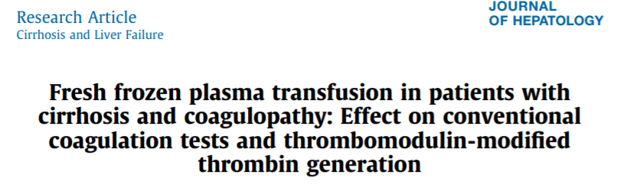
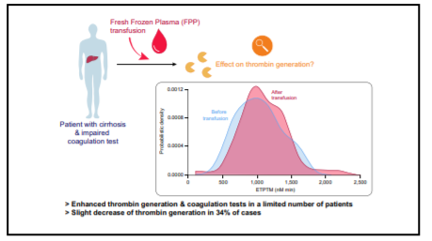
FFP does not make the numbers that matter better
FFP reduces thrombin generation

Slide 45
FFP
TACO
TRALI
Raised portal pressure

Slide 46
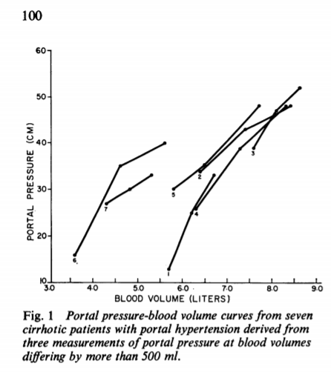
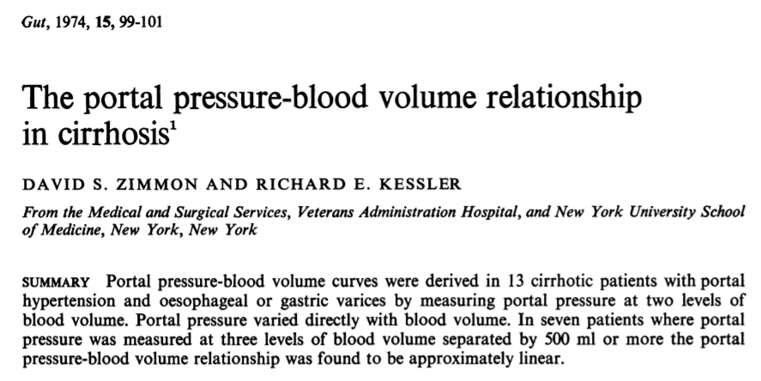
2 units of FFP have the potential to
double the portal pressure

Slide 47
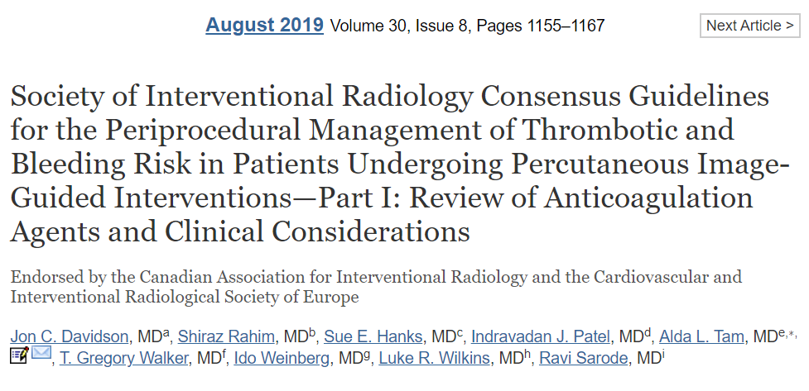
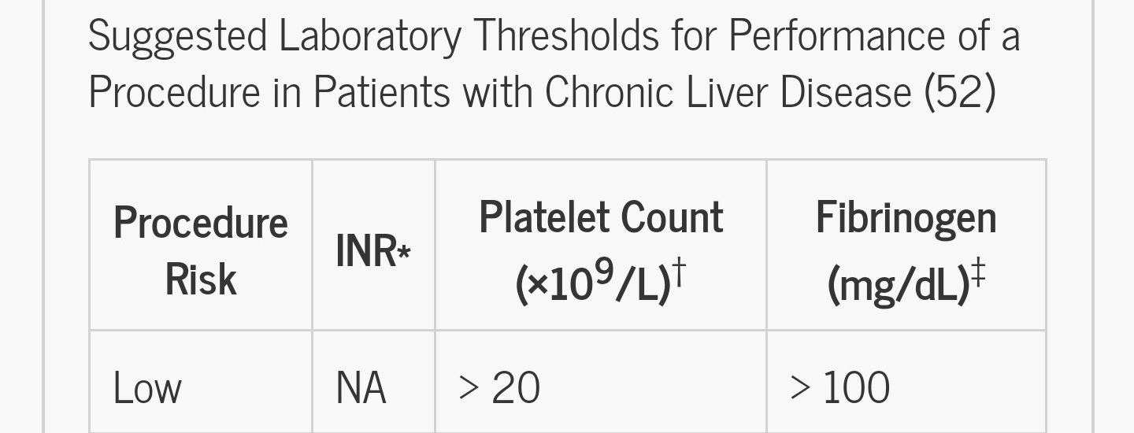
RADIOLOGY Guidelines Say: No FFP
Paracentesis is low risk

Slide 48
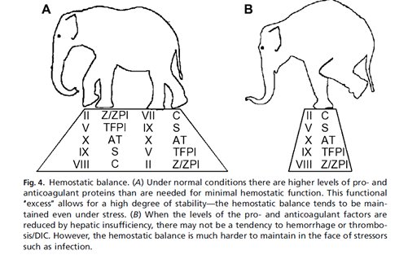
Rebalanced
hemostasis
Clin Liver Dis. 2009 Feb;13(1):1-9

Slide 49
Advanced Care & Advanced Care Planning

Slide 50
Perioperative Risk
Is this patient optimized for the surgery?
  Risk Assessment Scores
  CTP & MELD correlate with increased mortality risk
    No discrete cutoff
    AGA: CTP >10 or MELD >20 “pose a high risk for postoperative decompensation and death”
  Mayo risk score: Age, ASA class, MELD
  VOCAL-Penn score: Surgical type/ urgency, BMI, NAFLD, Alb, Tbili, Plts, ASA class
@SuchitaSata
Notes:
Optimal preparation with attention toward cirrhosis complications during perioperative period may decrease the risk of complications or death following surgery. Preparation should include correction of coagulopathy, treating preexisting encephalopathy, controlling ascites, preventing sepsis, and optimizing renal function
Consider nonsurgical therapies when appropriate
AGA: “Patients with Child-Pugh class C (CTP score >10) or a MELD score >20 pose a high risk for postoperative decompensation and death. Avoid or delay until after liver transplantation, if possible, all but the most urgent and lifesaving procedures in this population”
-malnutrition (BMI >30 is protective)
-coagulopathy
-sepsis
-encephalopathy
-medication metabolism
Mayo score -
VOCAL-Penn score — in VA cohort

Slide 51
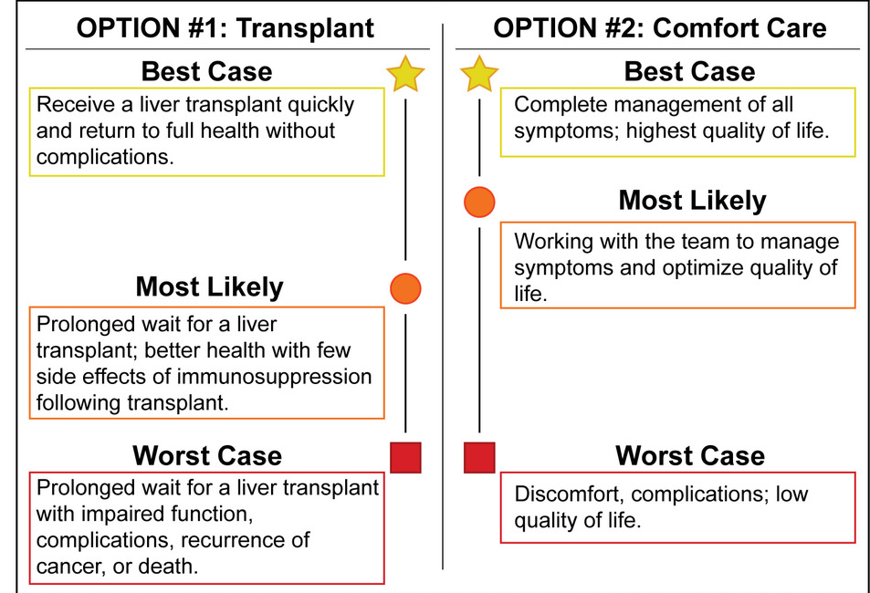
Transplantation and Palliation
Cirrhosis is a progressive, end-stage disease associated with poor Health-Related Quality of Life
Common symptoms
  Pain → adjust for impaired clearance
  acetaminophen 2g daily max
  Pruritus → cholestyramine
  Muscle cramps → baclofen
  Insomnia → melatonin, zolpidem
Rogal et al, Hepatology 2022
@SuchitaSata
Notes:
Evaluation for LT should be considered once a patient with cirrhosis has experienced an index complication such as ascites, hepatic encephalopathy, or variceal hemorrhage or hepatocellular dysfunction results in a MELD Score ≥15 (1-A)
Martin, Paul1; DiMartini, Andrea2; Feng, Sandy3; Brown, Robert Jr.4; Fallon, Michael5. Evaluation for liver transplantation in adults: 2013 practice guideline by the American Association for the Study of Liver Diseases and the American Society of Transplantation. Hepatology 59(3):p 1144-1165, March 2014. | DOI: 10.1002/hep.26972

Slide 52
Transplantation and Palliation
Palliative care can be provided at any stage of a serious illness
Advance care planning is essential and the responsibility of all clinicians
Address underlying causes early (AUD, HCV, etc)
Early referral to a Transplant Hepatologist
  After index complication
  MELD ≥ 15
  * small females often have low Cr and MELD-Na is comparatively lower
@SuchitaSata
Notes:
In this talk we had the cases of Mr Murphy, Mrs Santos, and Mr Jackson.
All should be referred for transplantation evaluation and/or ACP
Evaluation for LT should be considered once a patient with cirrhosis has experienced an index complication such as ascites, hepatic encephalopathy, or variceal hemorrhage or hepatocellular dysfunction results in a MELD Score ≥15 (1-A)
Martin, Paul1; DiMartini, Andrea2; Feng, Sandy3; Brown, Robert Jr.4; Fallon, Michael5. Evaluation for liver transplantation in adults: 2013 practice guideline by the American Association for the Study of Liver Diseases and the American Society of Transplantation. Hepatology 59(3):p 1144-1165, March 2014. | DOI: 10.1002/hep.26972

Slide 53
Alcohol Use Disorder

Slide 54

Alcohol use disorder

Slide 55
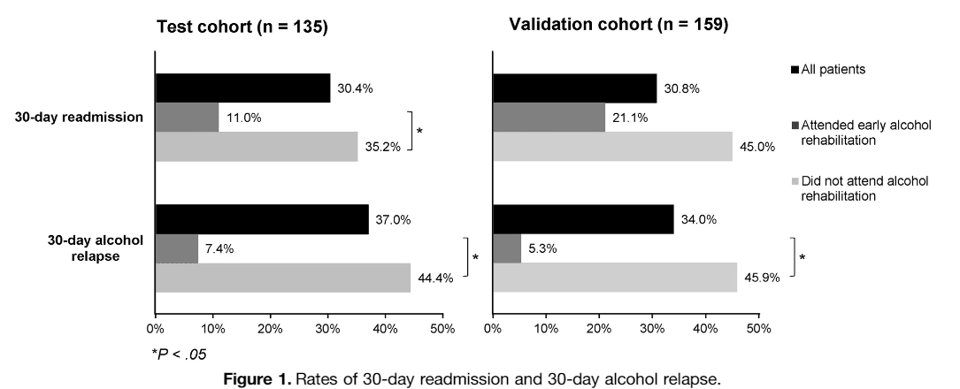
Linkage to care for alcohol

Slide 56
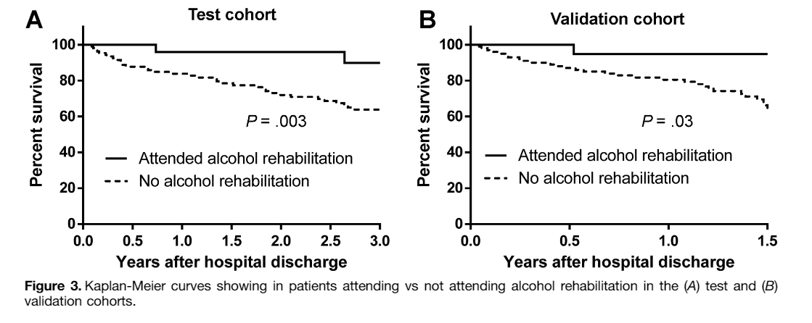
Linkage to care for alcohol

Slide 57
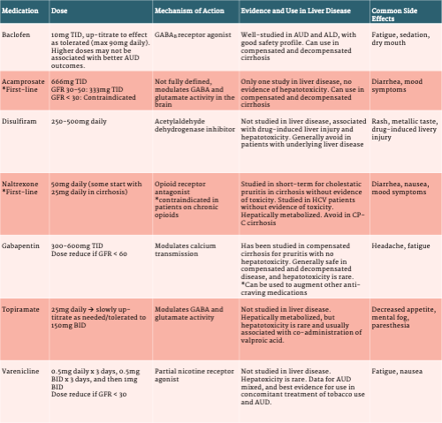
Spotlight on: Alcohol use disorder
Naltrexone (PO/IM)
Gabapentin
(prevent withdrawal)
Dr. Sasha Deutsch-Link
Liverfellow.com

Slide 58
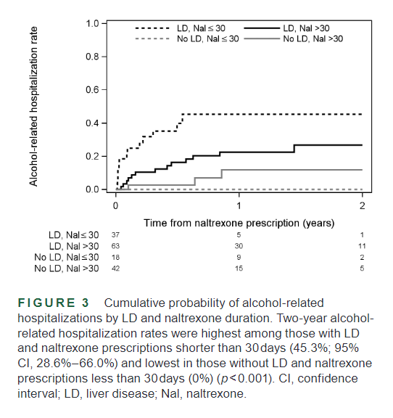
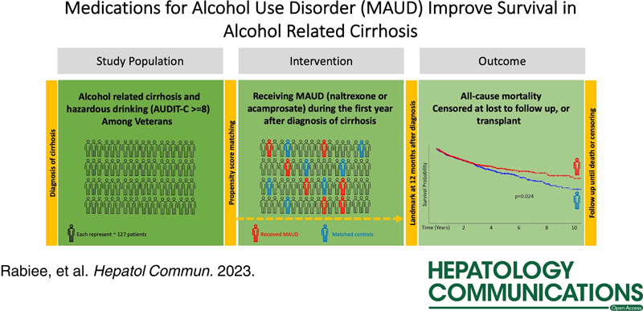
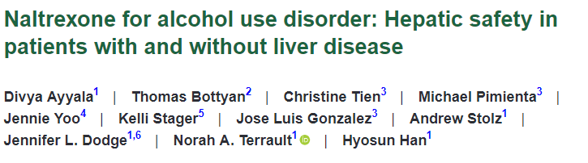

Slide 59
Discussion

